Slide 1
SDN and NFV
An overview of SDN and NFV Architecture and Use Cases
The audience will be muted during this presentation.
Please type your questions in the IM window.
25th November, 2016
Chakkan, Abhilash Thottakath
Nimmagadda M Syamsundar

Slide 2
Agenda
What is NV
Introduction to SDN
Need for SDN
Defining SDN
Introduction to NFV
SDN vs NFV
Use Cases of SDN
Use Cases of NFV
Defining NFV
VNF Examples
Conclusion

Slide 3
Network Virtualization(NV)
Network virtualization is the process of combining hardware and software network resources and network functionality into a single, software-based administrative entity, a virtual network.

Slide 21
Introduction to NFV

Slide 22
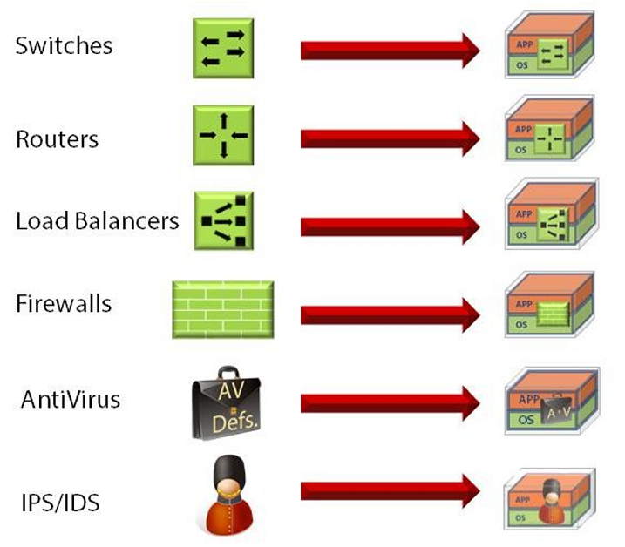
Introduction to NFV(Contd.)
Describing What NFV Does

Slide 23
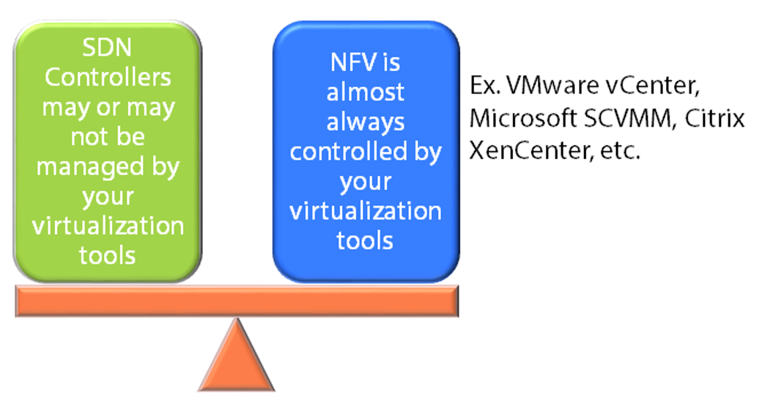
Introduction to NFV(Contd.)
How is NFV Different from SDN
While SDN is typically thought of as managing and automating tasks for physical devices, NFV is all about provisioning new networking devices.
SDN may then be used to manage the new virtual as well as the existing physical devices.

Slide 25
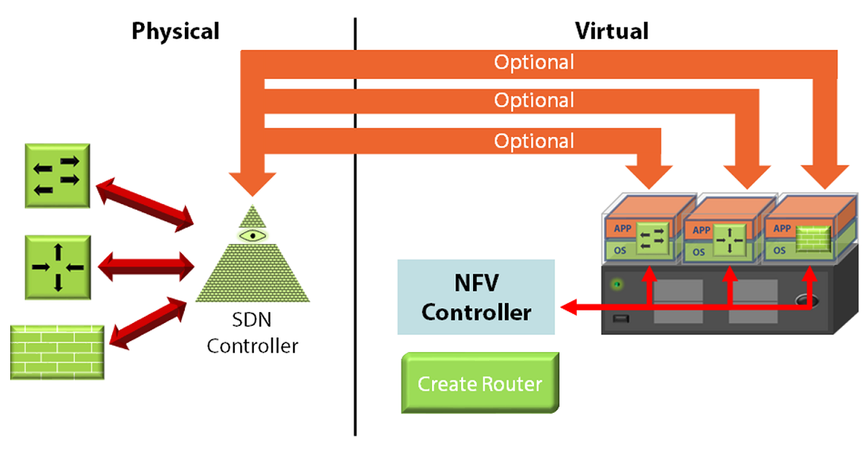
Illustration of SDN vs NFV

Slide 26
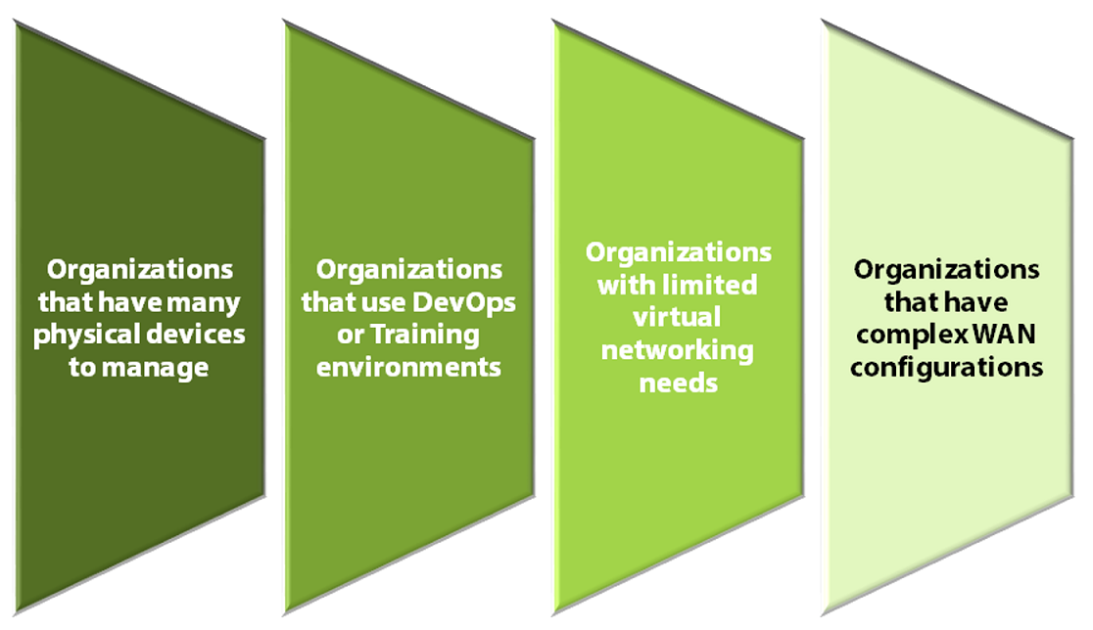
Use Cases of SDN

Slide 27
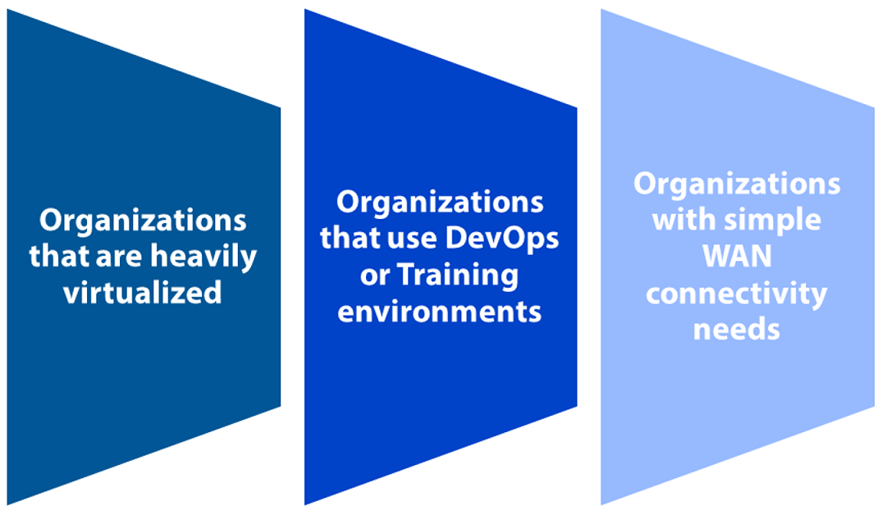
Use Cases of NFV

Slide 28
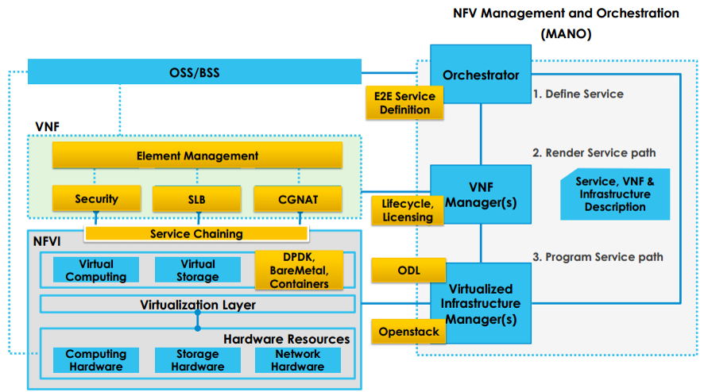
Defining NFV

Slide 29
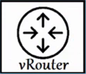
VNF Examples
IMS VNF
Firewall VNF
Router VNF

Slide 30
Conclusion
In this presentation, we discussed about how SDN and NFV solves the real time network problems encountered today and in future

Slide 31
Thank You
Questions ?

